Slide 1
Why Christians lost the culture war
Keith Rice

Slide 2
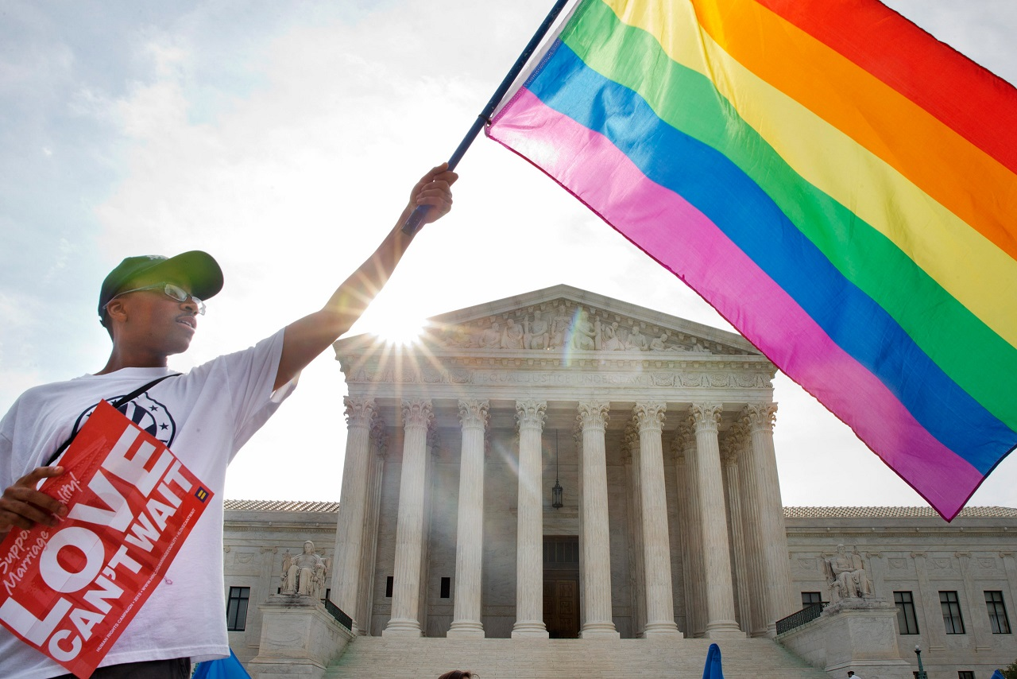
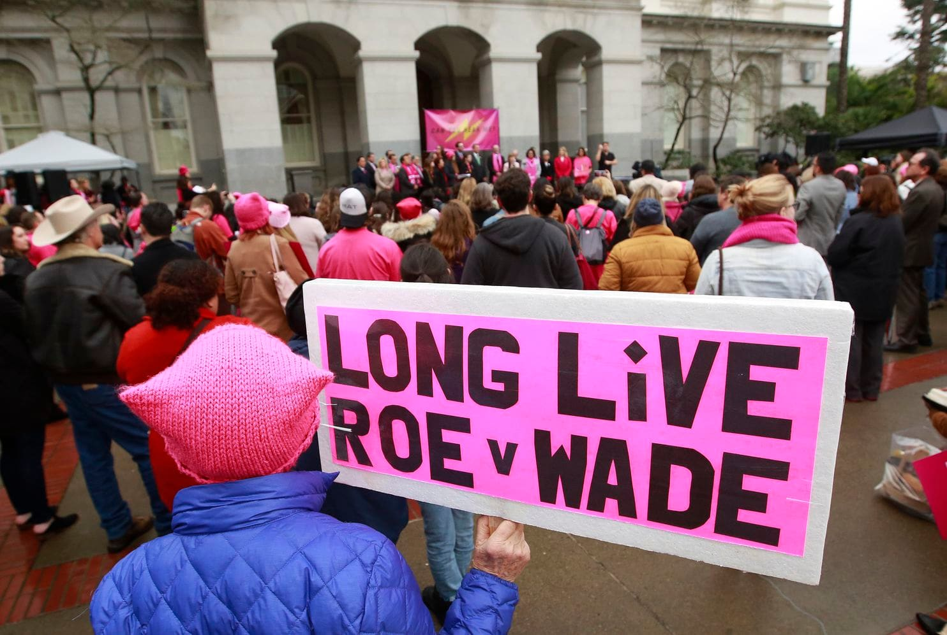
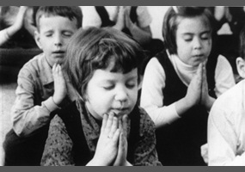

Slide 3
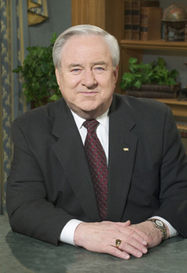
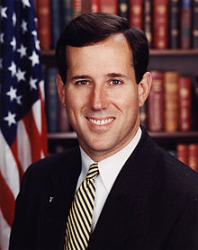

Slide 5
What is the culture war?
Struggle between ideological groups over the prevailing moral standards in a culture.
In America, commonly viewed as “conservatism” versus “liberalism”
In Christendom, commonly viewed as Christianity versus humanism
Strong association with Christian activism
What kinds of moral standards? Any moral standards that affect culture:
Laws
Foreign relations
Education
Art / Music / Film
Technology

Slide 6
When did we lose the war?
When Roe v Wade was decided?
When routine prayer was removed from public school?
When Christian bakers could get sued for discrimination?
When premarital sex became the norm?
When the percentage of professing Christians dropped to X%?
Were we ever a Christian culture to begin with?
Notes:
Loss of the universities
Scopes Monkey Trials

Slide 7
Does it even matter?
Are Christians supposed to fight a culture war?
Are Christians supposed to be politically active?
Are Christians called to redeem culture?
Anti-activism opinion: the Bible doesn’t command activism or give any examples of activism; focuses on symptoms.
Pro-activism opinion: the Bible commands Christians to be salt light and its impossible to do this without activism.
Authentically Christian activism should never replace evangelism or promote legalism.
Notes:
“No matter how commendable the goal of such tactics, there is not one example in the entire Bible of political or social "activism" ever being advocated or used by God's people. That fact must weigh heavily upon any consideration of this important topic. There are numerous cases of civil disobedience in Scripture, but it was never engaged in for the purpose of forcing an ungodly society to obey Biblical principles.”
Micah 6:8 -- He has told you, O man, what is good; and what does the LORD require of you but to do justice, and to love kindness, and to walk humbly with your God?

Slide 8
Reason #1: Hypocrisy
Personal moral failings
Usually a sexual or financial scandal that destroys someone’s reputation
Personal moral apathy
Seemingly insignificant instances of sin that erode our credibility
Organizational moral failings
Southern Baptist Church and slavery

Slide 9
Reason #2: imbalance
You oppose pornography and strip clubs…
...but do you support safe shelters for abused or trafficked women?
You oppose abortion and premarital sex…
…but do you promote adoption, fostering, and pregnancy resource centers? Do you support single mothers?
You oppose homosexual marriage…
…but do you still befriend homosexuals?
“For this is the will of God, that by doing good you should put to silence the ignorance of foolish people.” (1 Peter 2:15)
“…perfect love casts out fear.” (1 John 4:18)
Notes:
“Are you fighting to hurt or fighting to heal?”
https://christianindex.org/how-to-lose-the-culture-war/

Slide 10
Reason #3: ignorance
Most Christians do not know their enemy
19th century liberalism crept over the US without much challenge
Many Christians think its sufficient to study what is true but not false
Many Christians feel uncomfortable doing apologetics
“[Troops came to David from] Issachar, men who had understanding of the times, to know what Israel ought to do, 200 chiefs, and all their kinsmen under their command.” (1 Chronicles 12:32)
“Test all things; hold fast what is good.” (1 Thess. 5:21)
Notes:
“Are you fighting to hurt or fighting to heal?”
https://christianindex.org/how-to-lose-the-culture-war/

Slide 11
Reason #3: bad arguments
How often do you hear culture warriors appeal to God?
We appeal to the man-made Constitution but not God’s word
Example with “gay marriage”:
“We’re the moral majority”
“This isn’t traditional” (or will breakdown traditional family)
“This isn’t natural” (or can’t be used for reproduction)
“This isn’t something you’re born with”
Example with abortion:
“Science says life begins at conception / it’s a human”

Slide 12
Reason #4: apathy
“The only thing necessary for the triumph of evil is for good men to do nothing.”
“Do not be slothful in zeal, be fervent in spirit, serve the Lord.” (Romans 12:11)
Do you have a fatalistic or negative attitude toward God can do in culture?

Slide 13
A challenge
Do you believe you are in a war?
How will you fight?
Not just the evil around you…
…but the evil within you
“Religion that is pure and undefiled before God the Father is this: to visit orphans and widows in their affliction, and to keep oneself unstained from the world.” (James 1:27)

Slide 14
Notable organizations
National and international
Answers in Genesis
International Justice Mission
Compassion International
Christian Alliance for Orphans
Shared Hope International
Local
Shared Hope International (Vancouver)
Caring Pregnancy Center (Longview)
Woodland Action (Woodland)

