Slide 1
Responding to Theism
Keith Rice

Slide 2
Last Week Summary
Secularism
The idea that state institutions should be separate from religious institutions.
The idea religion is ought to be a purely private matter (and therefore shouldn’t influence society in any way) because it is useless or harmful.
“Keep your religion to yourself”
Secularism wins debate not with facts but by precluding Christianity from the debate

Slide 3
Last Week Summary (cont.)
Christians failed to call out secularism as false and proclaim Christianity as true
“Christianity is not being brilliantly attacked, it is being incompetently defended.”
Theo. liberalism: “It’s OK to be a private religion”
We’re in the “Moral Majority”
“Let’s get back to the good old days” plea
Do Christians want a theocracy?

Slide 4
“What About the Other Guys?”
How do you reduce to absurdity a worldview that claims the same epistemological advantages as Christianity?
Epistemological arguments won’t usually persuade

Slide 6
Responding to Other Theists
Understand your opponent’s worldview
If they’re hiding behind a thought experiment…
Point it out that they are hiding
“Hypothetical gods only give hypoth. Knowledge”
Yahweh did reveal himself
If they’re a true adherent
Find a key contradiction in their worldview
Proclaim superiority of Christianity in similar regard and include evidence, if desirable

Slide 7
Debate Advice
When reducing a worldview to absurdity
Stay focused on one or two key points and do not let them drag you into tangential issues
Avoid points that mock or anger your opponent without touching the heart of the worldview
Examples
Mormonism: How many heavens are there? Did Jesus preach in North America?
Mormonism: Was Joseph Smith a charlatan?; Islam: Focusing on Islamic terrorism; Both: misogyny

Slide 8
Pseudo-Christian Sects
Notice I avoided the word “cults”
Catholicism, Mormonism, JW’s, etc
Three major points they get wrong
Revelation: canon wasn’t closed after apostles
Theology proper: unitarianism (exception: Cathol.)
Salvation: works-based
If you had to pick one only: the gospel

Slide 9
Scriptural Ammunition
The canon is closed
Jude 3: “the faith once for all delivered”
Use Rev. 22:19 as a conclusion, not an argument
Christ is God
John 8:58 – “Before Abraham was, I AM”
Col 1: All things created through Christ
Revelation: Jesus is alpha and omega
Trinity
Attributes of God are applied to all three persons
Matthew 28:19, Genesis 1: “Let us create”

Slide 10
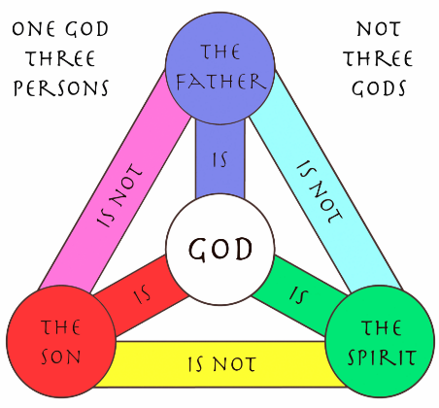

Slide 11
Scriptural Ammunition (cont.)
Salvation is by grace alone through faith alone in Christ alone
Every book makes this clear but Ephesians 2, Romans 4 are perhaps the most blunt
James 2:24 is obviously using justification in a different sense: faith without works is dead
Rom. 2:6-7 is a trap for the logically impaired: salvation is conditioned on but not caused by works
Legalism: Faith + Works = Salvation
Christianity: Faith = Salvation + Works

Slide 12
Judaism
Judaism, like Christianity, is very diverse
What not to focus on
The Jewish obsession with customs and practices, national identity, Zionism, etc.
What to focus on
Jesus as the Messiah: the OT predicts him
Legalism: the OT does not support it

Slide 13
Islam
Islam, like Christianity, is very diverse
What not to focus on: terrorism
Islam is heavily divided on this topic
The anti-terrorism laws in Muslim countries are harsher than US anti-terrorism laws
What to focus on
Quran’s praise of the Bible and Jesus
The problem of Allah’s holiness: sin isn’t atoned for
The lack of certainty of salvation in Islam*
Advanced: contradictions between the “Mecca Quran”
and the “Medina Quran”
Notes:
*Technically not a contradiction

Slide 15
New Age / Mysticism
Technically not theism, but not worthy of an entire class
Benefits of theism without its accountability
Vague epistemology
Keep asking them “how do you know that” and they’ll run themselves into the ground quickly
Notes:
Spirituality-infused self-help philosophy

