Slide 1
War of the Worldviews
Keith Rice

Slide 2
Last Week Summary
Apologetics is rationally contending for the truth of the Christian worldview.
1 Peter 3:15, 2 Cor. 10:4-5, Jude 3
“But sanctify the Lord God in your hearts”
Christ is Lord even when we’re persuading others that Christ is Lord!

Slide 3
What’s A Worldview?
The entire set of beliefs that determines how we explain and interpret our experience.
Not to be confused with a “worldly-view”
The “eyes” through which we view the world.
Everyone has a worldview.
Worldviews are not easily changed.

Slide 4
Worldview “X-ray” Questions
MEANING: What is my purpose?
MORALITY: How should I live? (ethics)
KNOWLEDGE: What is true? (epistemology)
REALITY: What is real? (metaphysics)
HISTORY: Where did everything come from and what’s in store for the future?

Slide 5
Popular Worldview Categories
Very high level categorization (Dr. Bill Brown):
Theism
Christianity, Catholicism, Mormonism, Islam, Judaism, “moralistic therapeutic deism”
Naturalism
Secular humanism, Marxism, postmodernism
Transcendentalism
Eastern religions, New Age, pantheism, paganism, mysticism
Notes:
Judeo-Christian worldview
Moralistic therapeutic deism (MTD) is a term that was first introduced in the book Soul Searching: The Religious and Spiritual Lives of American Teenagers (2005) by sociologists Christian Smith and Melinda Lundquist Denton. The term is used to describe what they consider to be the common religious beliefs among American youth. The book is the result of the research project the "National Study of Youth and Religion".
The authors find that many young people believed in several moral statutes not exclusive to any of the major world religions. It is this combination of beliefs that they label Moralistic Therapeutic Deism:
A god exists who created and ordered the world and watches over human life on earth.
God wants people to be good, nice, and fair to each other, as taught in the Bible and by most world religions.
The central goal of life is to be happy and to feel good about oneself.
God does not need to be particularly involved in one's life except when God is needed to resolve a problem.
Good people go to heaven when they die.
These points of belief were compiled from interviews with approximately 3,000 teenagers.^{[4]}

Slide 7
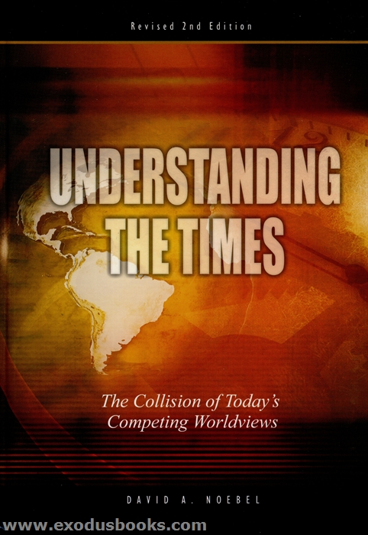

Slide 8
Scriptural Worldview Categories
Is this how scripture categorizes worldviews?
1 Cor. 1:20-25, Prov. 1:7, Col. 2:3, 8, Eph. 2:1-2
Scriptural categorization:
Christianity
Non-Christianity
Key point: There are, fundamentally, only two worldviews
Notes:
Judeo-Christian worldview

Slide 9
Engaging Culture Biblically
Most cultures have a prevailing worldview
In scripture, the most effective evangelists and apologists “understood the times”
1 Ch. 12:20,32, Dan. 1:17,20, Acts 17:16-17

Slide 10
Three Responses to Culture
Three ways to respond to a godless culture:
Offended → Withdraw
Delighted → Assimilate
Distressed → Engage
Paul’s motivation (distress) moved him to action (engagement)

