Slide 1
Introduction to Apologetics
Keith Rice

Slide 5
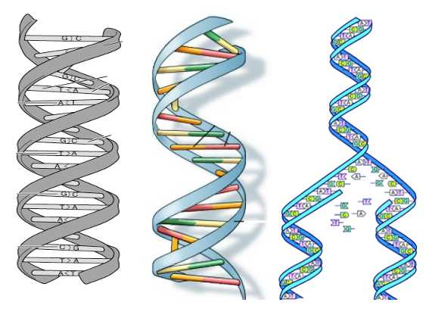

Slide 8
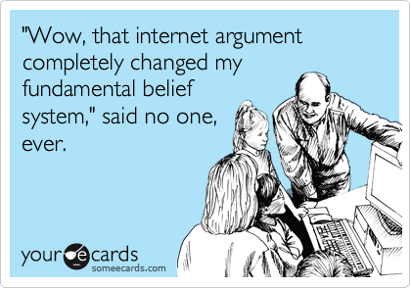

Slide 9
What is apologetics?
From Greek “apologia”, meaning a legal defense. Used in Acts 26:2, 1 Peter 3:15.
Encompasses polemics as well (Jude 1:3, 2 Cor. 10:4-5)
Is both offensive and defensive. “Defense of the faith” is insufficient.
Robust definition: “Intellectually contending for the truth of the Christian worldview.”

Slide 10
Unpacking the definition
Intellectual: As opposed to physical.
Contend: Emphasizes offense (polemics) and defense (“apologia”).
Truth: As opposed to pragmatism, tradition, common sense, or a particular Christian.
Christian: As opposed to religion, theism.
Worldview: As opposed to culture, gov’t.
Notes:
Intellectual: the battleground is in the mind.
"Christians argue with unbelievers, we do not arrest them. Christians answer unbelievers, we do not apprehend them. Christians consider, we do not capture. Christians debate and discuss, we do not detain. Christians explain, we do not execute. Christians intercede, we do not incarcerate. Christians pray, we do not punish. Christians reason, we do not retaliate. Christians speak, we do not seize. Christians teach, we do not torture." –John Robbins, Trinity Foundation
Truth: Testimonial apologetics can emphasize pragmatism.
Truth: It may be worth defending John Calvin or Martin Luther or some other Christian who is under attack as an act of brotherly love and desire to not see someone slandered, but this is not apologetics.

Slide 11
Why do apologetics?
Exaltation
Worship God with our minds
Obey his command to apologize
Proclaim truth
Edification
Strengthen church and encourage saints
Evangelism
Exposing the self-worship of sinners and calling them to repentance and faith in the true God of knowledge
Notes:
In some Christian cultures there is a decidedly anti-intellectual bent. An emphasis on emotions, feeling, and experience rather thinking, knowing, and doctrine.

Slide 12
Who, Where, and When?
1 Peter, 1 Corinthians, and Jude were written to “pilgrims”, “saints”, and the “called” (elect).
Apologetics is not supposed to be for ivory-tower intellectuals and academics only.
Anywhere its appropriate to talk about ideas, its appropriate to do apologetics.
Always be ready! (1 Pet. 3:15, 2 Tim 4:1-5)
Notes:
Who: Every believer is equipped to “cast down imaginations” and “contend for the faith”, not because we are so wise and articulate (1 Cor 2) but because God’s word is “sharper than any two-edged sword” and it does not return void.

Slide 13
How to do apologetics?
Humbly (1 Pet. 3:15, 2 Tim. 2:25))
Gently (2 Tim. 2:24)
Graciously (Col. 4:6)
Boldly (Eph. 6:19-20)
Wisely (2 Tim. 2:23, Prov. 26:4)
“Sanctify the Lord God in your hearts”:
When we do apologetics, the preeminence of Jesus Christ should be apparent.

Slide 14
“Atheists say that no one can prove the existence of God, and well, they're right. But I say no one can disprove that God exists. But the only way to debate this issue is to look at the available evidence, and that's what we're going to do. We're going to put God on trial, with Professor Radisson as the prosecutor, and me as the defense attorney, and you as the jury.” – Josh Wheaton, God’s Not Dead

Slide 15
The Preeminence of Christ
“The fear of the Lord is the beginning of knowledge.” (Prov. 1:7)
“The Lord is the God knowledge.” (1 Sam. 2:3)
“Sanctify them by your truth. Your word is truth.” (John 17:17)
God claims that he is the ultimate arbiter of truth and our apologetic should affirm this.

