Slide 1
Science and Christianity
Part One: Rethinking Science
Keith Rice

Slide 2
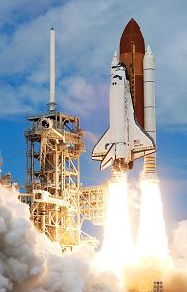
Science in Western Society
Shapes every aspect of our lives, rightly or wrongly
Many of the greatest human achievements in modern history are science related
Almost no one criticizes science on any level
Notes:
To say Western Culture values science would be an understatement

Slide 3
Science As Source of Truth
Both academia and popular culture agree:
Science is a source of knowledge, possibly even the best source
Science, when done correctly, is objective and makes no appeals to authority
“Scientific realism” – the belief that science produces a true account of the physical world

Slide 4
Science = Reason
National Geographic, March 2015: “Skepticism about science is on the rise … What’s causing reasonable people to doubt reason?” “Science holds that Earth is 4.6 billion years old, that all life evolved from microbes, and that modern humans first appeared 200,000 years ago…”

Slide 6
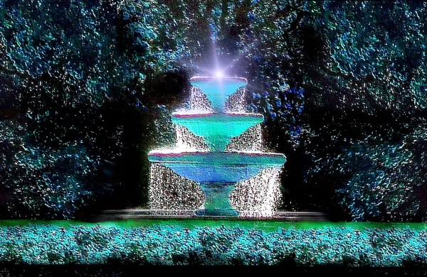

Slide 8
Questioning Assumptions
What if the person in the white lab isn’t neutral and can’t be even if they want to be?
What if certain questions can’t be answered by science at all?
What if science isn’t even a source of knowledge?

Slide 9
A Controversial Thesis
Science is useful but it is not a source of knowledge.
Notes:
You will find nothing if you search for this!
“Whoa, let me make sure I heard you correctly. I would grant that science isn’t the only source of knowledge, and I would even grant that it’s not the best source of knowledge, but not knowledge at all? Not even if in the physical realm?”
“So all of the scientific laws? None of that is true.”
Correct.

Slide 10
Defining Terms: Science
Science
Forming hypotheses about physical phenomena and conducting experiments to test those hypotheses.
Scientific experiments must be…
Testable
Repeatable
Observable
Notes:
Many people confused empirical observations with science.

Slide 11
Defining Terms: Knowledge
Knowledge
Justified, true belief
Epistemology
Branch of philosophy that studies the nature, origin, and limits of knowledge.

Slide 12
Several Problems
Problems inherent to the scientific method
Scientific experiments are fallacious
Scientific laws are based on induction
Scientific equations are selected, not discovered
Scientific laws don’t describe real situations
Scientific theories are based on unverifiable assumptions
Problems with scientists
Scientists are prone to error
Scientists unavoidably biased

Slide 13
Scientific Experiments Are Fallacious
Valid deductive syllogism:
Premise 1: If it is raining then the streets are wet
Premise 2: It is raining
Conclusion: The streets are wet
Invalid syllogism:
Premise 1: If it is raining then the streets are wet
Premise 2: The streets are wet
Conclusion: It is raining
“Asserting the consequent”
Notes:
Asserting the consequent is also known as “abductive reasoning”
Used constantly in law, medicine, and other areas of problem solving
“Reasoning to the best conclusion”

Slide 14
Sc. Experiments Are Fallacious (cont.)
Examples in science
Premise 1: If Einstein’s theory of relativity is true then gravity bends light
Premise 2: Gravity bends light
Conclusion: Einstein’s theory of relativity is true

Slide 16
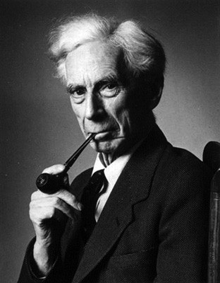
Sc. Experiments Are Fallacious (cont.)
“All [abductive] arguments in the last resort reduce themselves to the following form: "If this is true, that is true: now that is true, therefore this is true." This argument is, of course, formally fallacious. Suppose I were to say: "If bread is a stone and stones are nourishing, then this bread will nourish me; now this bread does nourish me; therefore it is a stone, and stones are nourishing." If I were to advance such an argument, I should certainly be thought foolish, yet it would not be fundamentally different from the argument upon which all scientific laws are based.” – Bertrand Russell

Slide 17
Scientific Laws Are Based On Induction
Premise 1: If Einstein’s theory of relativity is true then gravity bends light
Premise 2: Gravity bends light
Conclusion: Einstein’s theory of relativity is true
Where does Premise 2 come from?
Observation
Have we observed this in every place and time?
No, but we assume it is true in every place and time via induction.
Notes:
Frequently it is stated that induction, even if it cannot provide an infallible conclusion, can at least provide us with a high probability of truth. Even this is not true, because scientists have no way of knowing what percentage of their observations are incorrect.

Slide 18
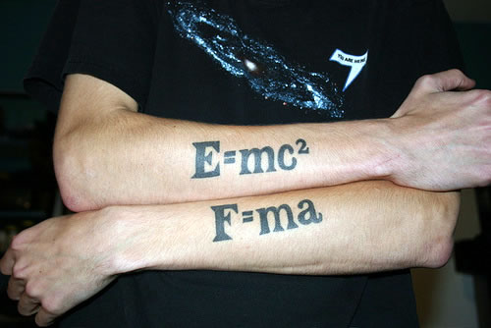
Scientific equations are selected, not discovered

Slide 19
Scientific equations are selected, not discovered
How do we know that force equals mass times acceleration (F = ma)?
Measure the acceleration of an object with mass m after applying different forces.
Plot the measurements on a graph and then use curve-fitting to obtain an equation within an arbitrarily chosen margin of error.

Slide 20
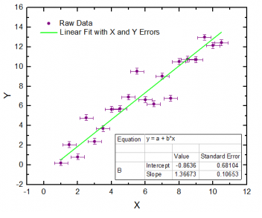
Scientific equations are selected, not discovered
Notes:
Since the margin of error is chosen arbitrarily, the equation is chosen by the scientist.

Slide 21
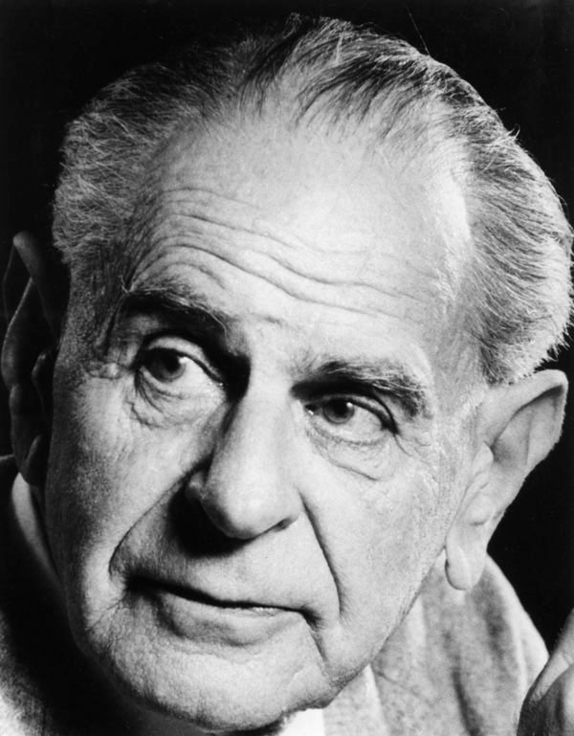
Scientific equations are selected, not discovered
Since an infinite number of data points exist within the margin of error, an infinite number of equations can be fitted. Yet only one is chosen by the scientist. The probability of it being the correct one is zero.
“It can even be shown that all theories, including the best, have the same probability, namely zero.” – Karl Popper

Slide 22
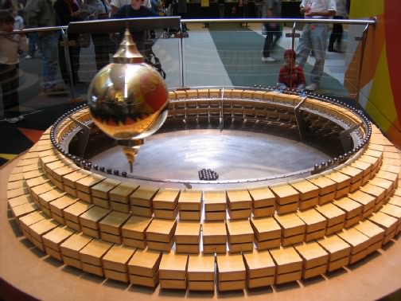
Scientific laws do not describe real situations
Notes:
E=mc2, c refers to speed of light in a vacuum, but we have never measured the speed of light in a vacuum.
"The law of the pendulum states that the period of the swing is proportional to the square root of the length. If, however, the weight of the bob is unevenly displaced around its center, the law will not hold. The law assumes that the bob is homogeneous, that the weight is symmetrically distributed along all axes, or more technically, that the mass is concentrated at a point. No such bob exists, and hence the law is not an accurate description of any tangible pendulum. Second, the law assumes that the pendulum swings by a tensionless string. There is no such string, so that the scientific law does not describe any real pendulum. And third, the law could be true only if the pendulum swung on an axis without friction. There is no such axis. It follows, therefore, that no visible pendulum accords with the mathematical formula and that the formula is not a description of any existing pendulum."

Slide 23
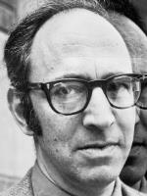
Scientific theories are based on unverifiable assumptions
“… a paradigm is prerequisite to the discovery of laws … We often hear that they are found by examining measurements undertaken for their own sake and without theoretical commitment. But history offers no support for so excessively Baconian a method.” – Thomas Kuhn, The Structure of Scientific Revolution

Slide 24
Scientists are fallible and biased
Science is only as trustworthy and infallible as the individuals doing science
How trustworthy are humans?
How infallible are humans?

Slide 25
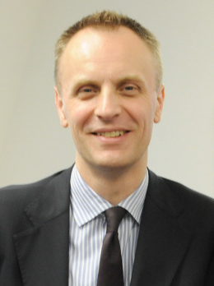
Scientists are fallible and biased
“The case against science is straightforward: much of the scientific literature, perhaps half, may simply be untrue. Afflicted by studies with small sample sizes, tiny effects, invalid exploratory analyses, and flagrant conflicts of interest, together with an obsession for pursuing fashionable trends of dubious importance, science has taken a turn towards darkness.” – Dr. Richard Horton, The Lancet

Slide 26
A Christian View of Science
What, then, is science, and what is it good for?
Science is a rational activity undertaken by humans to help them accomplish material goals.
Ideally, science is an activity undertaken by humans to help them fulfill the dominion mandate (i.e. subduing the earth).

Slide 27
Responding to a criticism
“You’re just saying that science doesn’t provide absolute truth. Well, no one claims that it provides absolute truth, so you’re merely attacking a straw man. Science is obviously close enough to the truth, otherwise it wouldn’t be so successful.”
We have no way of knowing if a theory is close to the truth without knowing the truth.
The success of a theory doesn’t make that theory true.

Slide 28
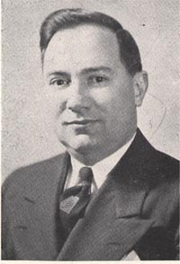
Acknowledgements
Gordon Haddon Clark (1902 – 1985)
Known for “scripturalism” and his role in the “Clark-Van Til controversy”
“Philosophy of Science and Belief in God”, available at www.TrinityFoundation.org
Notes:
Chairman of the philosophy department at Butler University for 28 years

Slide 29
Next Week: Implications
Can we use science to prove or disprove any worldview?
What are the preconditions of science?
Is science an inherently atheistic activity, since it seems to presuppose that only the natural world exists?
Should science shape how we interpret scripture, such as the book of Genesis?
If science isn’t knowledge, what is?

