Slide 1
Every Thought Captive: Race and Racism (Part One)
Keith Rice
Notes:
Biological races
A way of categorizing humans by their genetics
Hot button issue

Slide 2
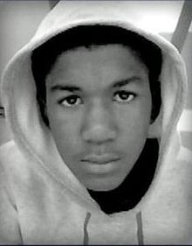
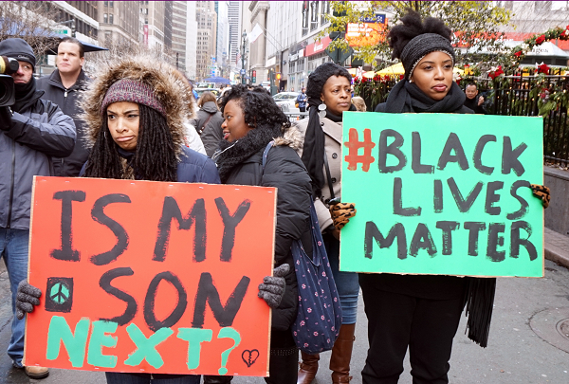
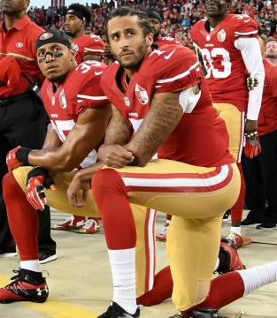
Notes:
We live in a multi-racial society
The issue of race has been a significant player in American history
US Civil War
Jim crow laws and segregation
Civil Rights Movement
Affirmative action
In this decade, the issue of race is hotter than ever due to numerous high-profiled incidents of black civilians being killed by white police officers
Trayvon Martin, Michael Brown, Eric Garner, Freddie Gray, Philando Castile
Prompted a reactionary movement which eventually came be known as “Black Lives Matter” (#BlackLivesMatter)
Colin Kaepernick refusing to stand for national anthem
Trump accused of racism, particularly toward Hispanics
The “browning of America”
The race issue does not seem settled at all and is probably the largest source of tension in the United States

Slide 3
Two Basic Responses
“Leftist” vs “rightist” caricature
Leftism accepts racial diversity
Rightism rejects racial diversity
This is WRONG
Many leftists reject racial diversity
Many rightists accept racial diversity
The two basic responses are
Acceptance of racial identity
Rejection of racial identity

Slide 4
The Heart of the Matter
If you want to have a meaningful conversation about race with ANYONE, the question that must be addressed is… racial identity.
Pro: “My race is a primary identifier. My race should be a primary factor in how people view me and treat me.”
This is the view of both “Black Lives Matter”… and white supremacists!
Notes:
How to tell if you pro-racial identity:
Do you get defensive when topics of race comes up?
When you hear news about race-related matters, do you think in terms of “us” and “them”?

Slide 5
Thesis
Racial identity is an unbiblical idea
If we want to eradicate racism then we must eradicate racial identity
Racial identity is accepted by most people, including Christians
Christians must lead the fight against racial identity
Notes:
This talk will cover the first two points
The next talk will cover the next two points

Slide 6
A Critique of Racial Identity
At the heart of racial identity is the idea that humans can be categorized by race
Problems
Race is not a biblical categorization
Race has no biological basis
Notes:
Reminder: Race is a biological categorization of humans

Slide 7
Race and the Bible
The Bible does not categorize by their skin color or genetic differences, but by their ethnicity.
They were singing a new song: "You are worthy to take the scroll and to open its seals because you were killed, and at the cost of your own blood you have purchased for God persons from every tribe, language, people, and nation.“ (Rev. 5:9)

Slide 8
Race and the Bible (cont.)
The Bible does acknowledge that certain physical traits are associated with nations
Can the Ethiopian change his skin, or the leopard his spots? then may ye also do good, that are accustomed to do evil. (Jer. 13:23)
… but this does not make these physical differences an identifier used by scripture.

Slide 9
Race and the Bible (cont.)
Interracial marriages in scripture
Rahab, a Canaanite, married an Israelite
Ruth, a Moabite, married an Israelite
Both are listed in Christ's genealogy
Other interracial relationships
Cornelius (Roman) and Peter (Jew)
Philip (Jew) and the Ethiopian (African)

Slide 10
Race and the Bible (cont.)
What scripture prohibits is believers marrying unbelievers (2 Cor 6:14)
Samson and Delilah
Solomon and his wives (1 Kings 11:4)
God condemns and punishes nations (due to their sinfulness), but never races
Assyrians, Babylonians, Egyptians, Canaanites, etc
Notes:
“For when Solomon was old his wives turned away his heart after other gods, and his heart was not wholly true to the LORD his God, as was the heart of David his father.” (1 Kings 11:4)

Slide 11
Race and the Bible (cont.)
The Bible does not recognize sub-groups of humans according to their genes
And He has made from one blood every nation of men to dwell on the face of the earth… (Acts 17:26)
Every human is descended from Noah, born ~3000 BC

Slide 12
Biblical Conclusion
“Race” is not a biblical concept
Then where did race come from?
In its modern form: Darwinism
On the Origin of Species by Means of Natural Selection or the Preservation of Favoured Races in the Struggle for Life
InThe Descent of Man, Darwin said what he knew he could not say in Origin of Species

Slide 13
Darwinism and Race
Ernst Haeckel:
At the lowest stage of human mental development are the Australians, some tribes of the Polynesians, and the Bushmen, Hottentots, and some of the Negro tribes. Nothing, however, is perhaps more remarkable in this respect, than that some of the wildest tribes in southern Asia and eastern Africa have no trace whatever of the first foundations of all human civilization, of family life, and marriage. They live together in herds, like apes.

Slide 14
Evolution and Race
Modern evolutionists are repudiating the racial implications of their philosophy.
Richard Lewontin:
As a biological rather than a social construct, “race” has ceased to be seen as a fundamental reality characterizing the human species.
...by far the largest amount of that variation, about 85%, is among individuals within local national or linguistic populations.

Slide 15
Creation or Evolution?
Evolutionists admit that there is little genetic variation within the human species
Big question: Does this fact fit better within a creationist worldview or evolutionary one?
“Mitochondrial Eve”
Biblical creation: 3000 years old
Evolution: 100-200,000 years

