Slide 1
Every Thought Captive: Immigration
Keith Rice

Slide 3
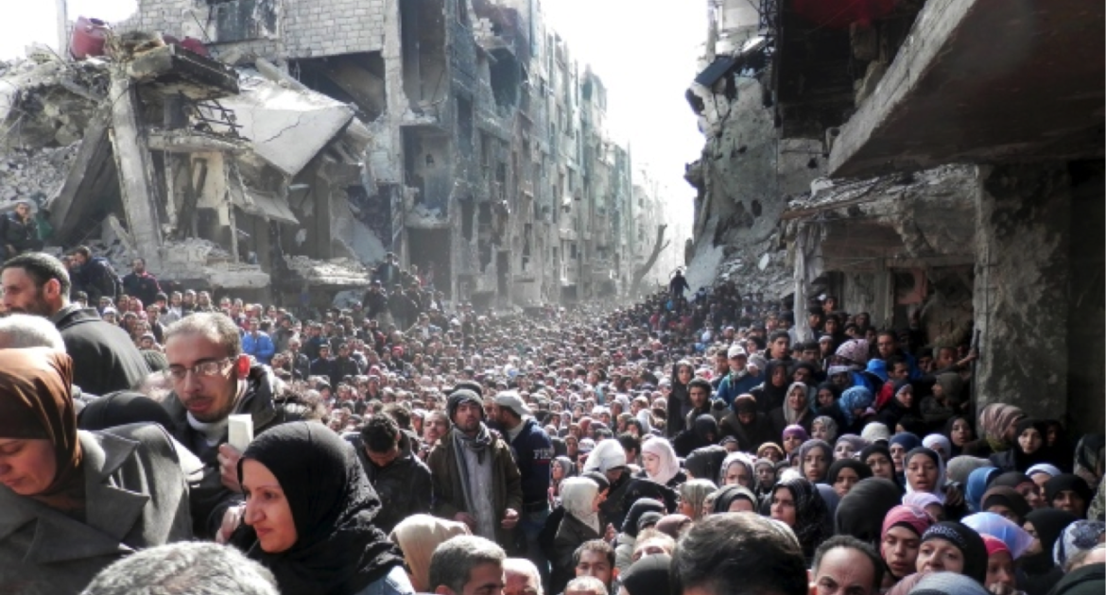

Slide 4
Immigration Causes Tension
Physical security
Do immigrants cause more crime?
Job security
Do immigrants take jobs from American workers?
Multiculturalism
Is a multicultural society a healthy society?

Slide 5
Bible On Immigration Part 1
Commands to migrate
Adam and Eve (Gen 3
Abram (Gen. 12:1)
Lot
Jacob and his family
Naomi and Ruth (Moab → Judah)
Notes:
Multicultural implications

Slide 6
Bible On Immigration Part 2
Laws concerning treatment of immigrants
Exodus 12:49
Exodus 22:21
Leviticus 23:22
Numbers 35
Deuteronomy 1:16
Deuteronomy 27:19
Notes:
The fact that immigrants are mentioned at all indicates that God recognized xenophobia (define) was a reality

Slide 7
Bible On Immigration Part 3
Spiritual analogies
I Chronicles 29:14-15
Ephesians 2
1 Peter 2:11
Hebrews 11:13-16

Slide 8
God’s Attitude Toward Immigrants
Positive, but…
1. Immigrants were expected to assimilate
Implications: No heightened insecurity, no multiculturalism
2. Jews still had preferential treatment
This is most evident in the slave laws
Implication (speculative): Any hard-working Jew would have job security

Slide 9
Questions Revisited
America is not Israel!
Physical security
Do immigrants cause more crime?
Job security
Do immigrants take jobs from American workers?
Multiculturalism
Is a multicultural society a healthy society?

Slide 10
Summary
Immigration is not a one-dimensional issue
Define your terms when you talk to others
Are politicians’ motives the Church’s motives?
Have you made comfort an idol?
Default Christian position
Welcome the immigrant
Never forget: you are an alien
We’re saved by an alien righteousness

